Slide 1
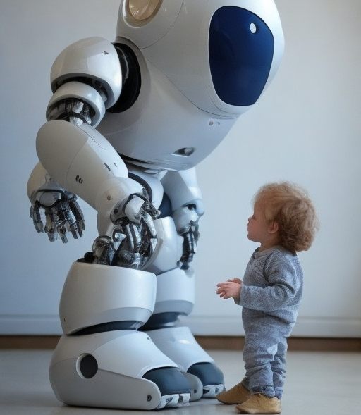
An Intelligent Robot For Monitoring And Protecting Toddlers
PROJECT ID -2023-326

Slide 2
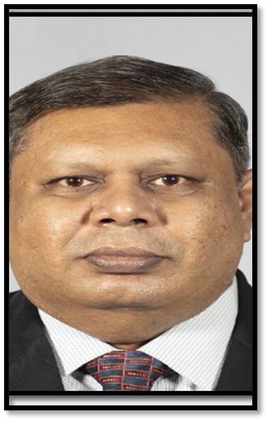
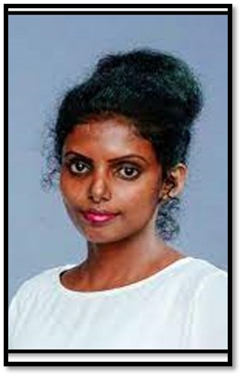
Research Project Supervisors
Supervisor :
Prof.Sanath Jayawardhne
Co – Supervisor :
Rangi Liyanage

Slide 3





Group Members
Ravindu Thuduhena
Shamal Weerarathne
Ravishka Lakshan
Danuka Maddepola

Slide 4
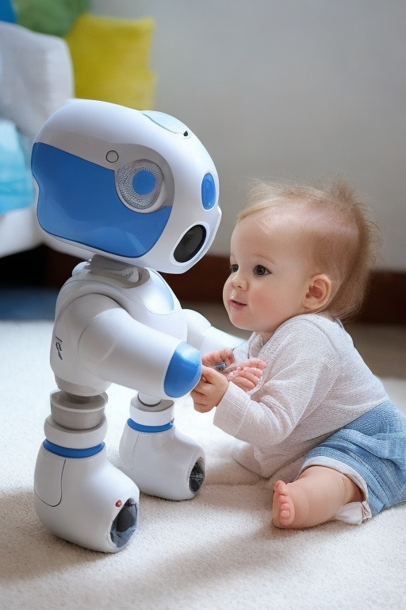
INTRODUCTION
Modern parents juggle hectic schedules, domestic tasks, and parenting responsibilities, making constant toddler supervision challenging.
Aim: Develop an intelligent remote child monitoring robot capable of detecting unauthorized presence and alerting parents.
Primary targeted beneficiaries include parents of toddlers aged 1-4, with potential applications in childcare centers, playgrounds, and nursery schools.
Key Technologies: Robotics, AI, ML, Image Processing, OpenCV

Slide 5

RESEARCH QUESTIONS
How can the toddler-protecting robot ensure continuous monitoring and safety for toddlers in the absence of sufficient supervision?
What innovative features can be integrated into the robot to safeguard toddlers from potential risks and hazards in various scenarios?
How can the robot be designed to provide caregivers with the flexibility to monitor toddlers while allowing the child the freedom to explore and grow?
Does the existing robot setup capable of capturing and responding to toddlers' emotions and behaviors?

Slide 6
FUNCTIONALITIES
Following the toddler with obstacle avoidance-based navigation.
Monitoring the toddler constantly while identify threats & environmental conditions.
Expelling animals away from the toddler that can be threatened to him.
Automatically play lullabies to soothe the toddler when he/she started to cry.
Send alerts to the parents after capturing dangerous behaviors of the toddler.

Slide 7

MAIN OBJECTIVE
To develop a robot capable of caring for toddlers in the absence of their parents. Overall, the research aims to create a technology that can enhance child safety and provide peace of mind for parents and caregivers.

Slide 8


SUB - OBJECTIVES
Developing a navigation system for the robot that can effectively and safely navigate around the toddler, incorporating the obstacle avoidance navigation and safe movement.
Mechanism for the toddler's surroundings to provide parental oversight, detect any unauthorized presence, and safeguard the toddler from identifying potential threats to the child's safety.
Designing a system for the recognition of toddler behaviors and subsequent notification to parents when deemed essential.
Developing a music playback system to soothe and relax toddlers, aiding in their tranquility.

Slide 9
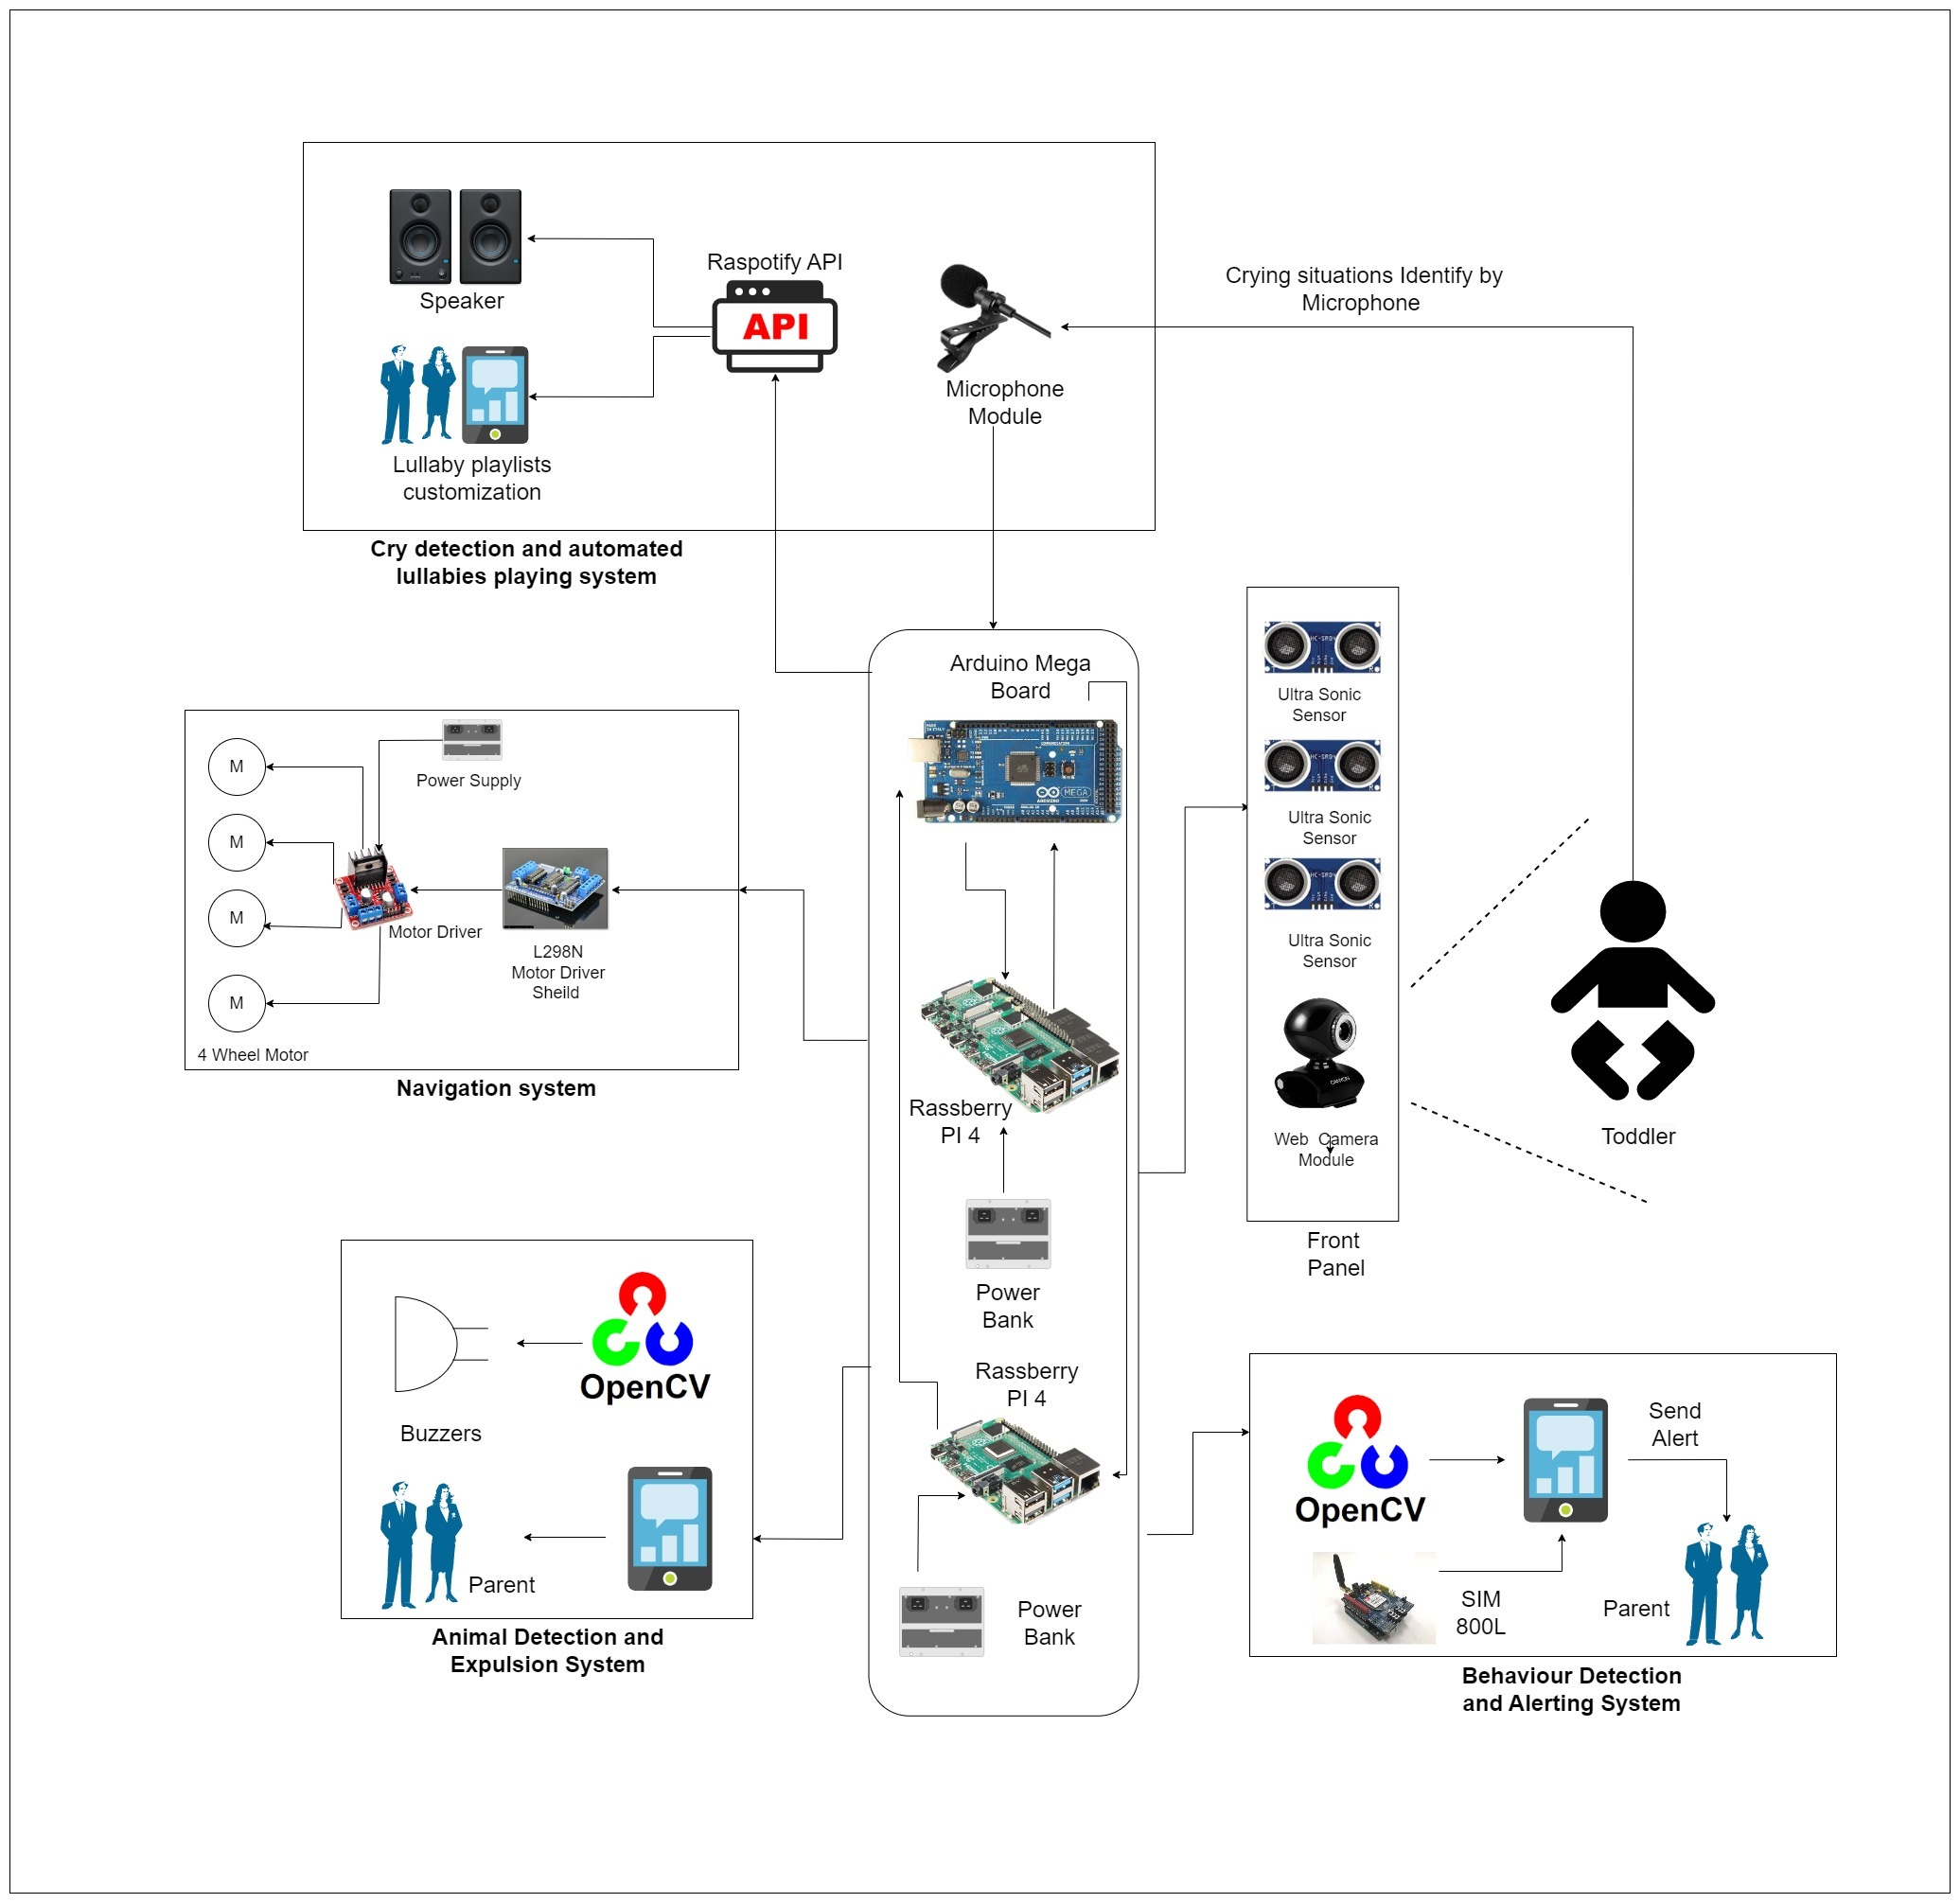
High-level
System
Architecture

Slide 10

IT20185466 | R.S Thuduhena
BSc (Hons) in Information Technology
Specializing in Computer Systems & Network Engineering
- Toddler Following and Obstacle Avoidance Robust Navigation System -

Slide 11
Introduction
Why toddler protecting robot needs navigation system ?
How this robot help to parents and
childcare givers ?
How robot follow the toddler ?
how robot identify the obstacles ?

Slide 12
Objectives
To effectively and safely navigate around a toddler.
To accurately tracking and following the toddler.
Incorporating the obstacle avoidance navigation.
Robot must be able to clear the area intelligently, for instance if the child interacts with or destroys it.

Slide 13

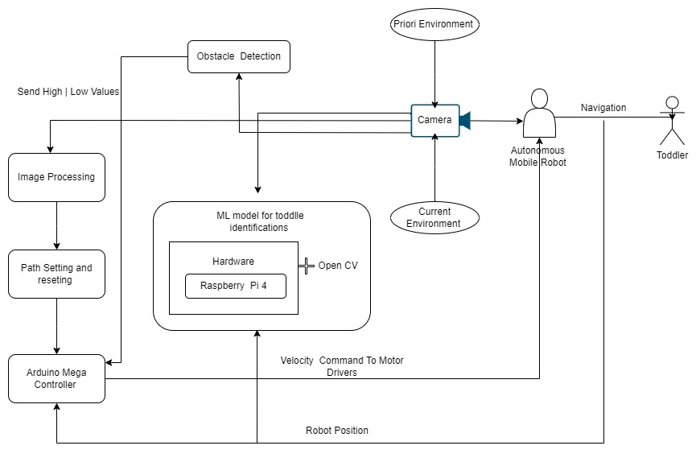
Methodology

Slide 14
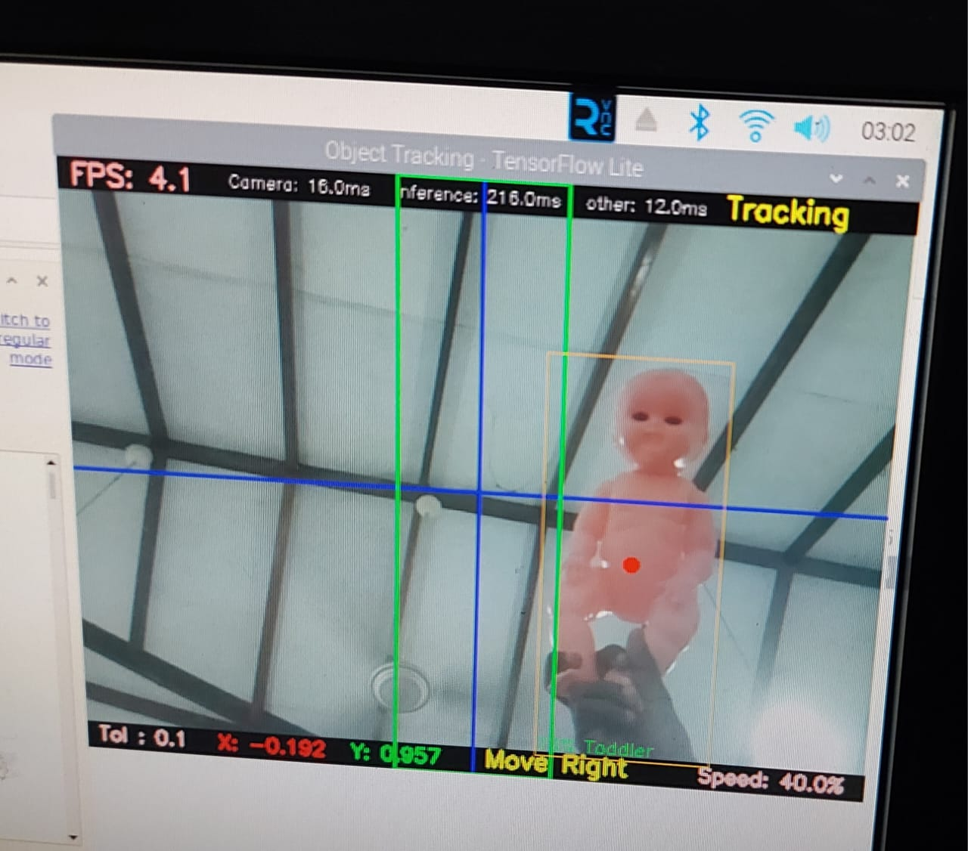
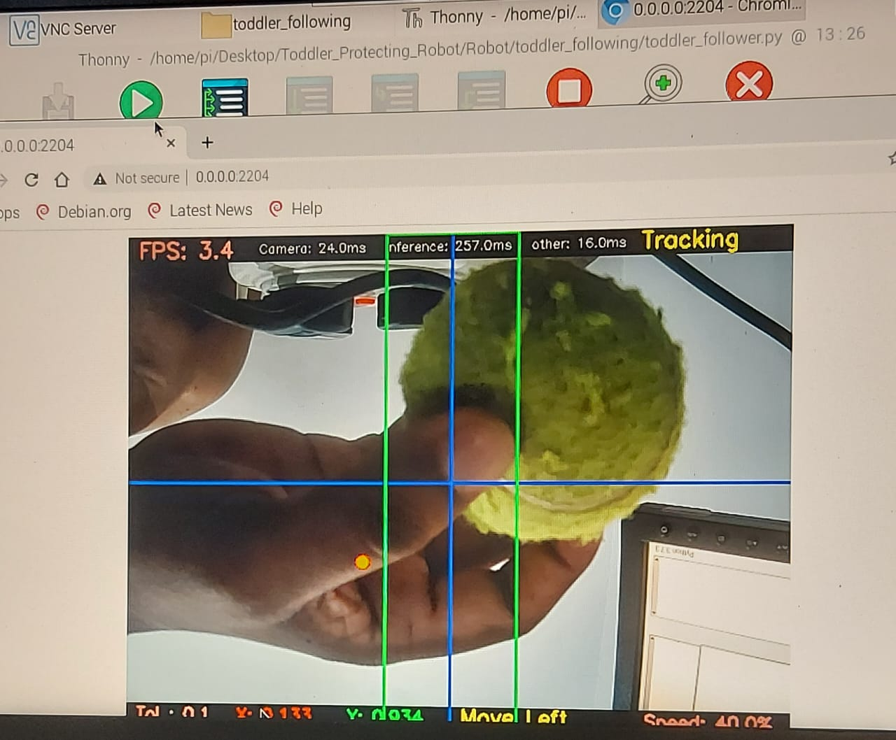
Testing and Results

Slide 15

References
Patrick Benavidez and Mo Jamshidi, “Mobile robot navigation and target tracking system,” 2011. Accessed: Aug. 01, 2023. [Online]. Available: https://ieeexplore.ieee.org/document/5966614
G. Kahn, P. Abbeel, and S. Levine, “BADGR: An Autonomous Self-Supervised Learning-Based Navigation System,” IEEE Robot Autom Lett, vol. 6, no. 2, pp. 1312–1319, Apr. 2021, doi: 10.1109/LRA.2021.3057023.
S.Arthika, S.Chidammabara Eswari, R.Prathipa and D.Devasena. “Bore well Child Fall Safeguarding Robot” (ICCSP 2018) published in the year 2018(IEEE).
Chunyan Ji, Thosini Bamunu Mudiyanselage, Yutong Gao and Yi Pan. “A review of infant cry analysis and classification” published in the year 2021(Springer).
Pruthvi Raj Myakala, Rajasree Nalumacha, Shivam Sharma and V.K.Mittal. “An Intelligent System for Infant Cry Detection and Information in Real Time”(ACIIW 2017) published in the year 2017(IEEE).
M.Benisha, Thandaiah Prabu R, Gowri.M, Vishali.K, Divya Priyadharshini.R, M.Anisha, Ponmozhi Chezhiyam and C.Jim Elliot. “Design of wearable device for child safety” (ICICV 2021) published in the year 2021(IEEE).

Slide 16

IT20280956 | Weerarathne R.M.S.S.
BSc (Hons) in Information Technology
Specializing in Computer Systems & Network Engineering
-Toddler Monitoring & Animal Detection System -

Slide 17
Introduction
Why toddler protecting robot needs animal detection and expulsion system ?
How will robot detect animals?
How this robot help to parents and childcare givers ?
How will robot expel animals?

Slide 18

Objectives
To real-time detect any unpermitted presence.
To identify potential threats to the child's safety.
To expel animals that can be threatened to toddler without harm for both animal and toddler.

Slide 19
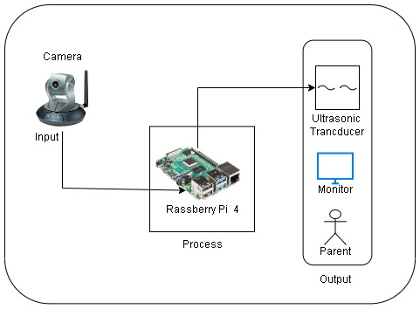
Methodology

Slide 20
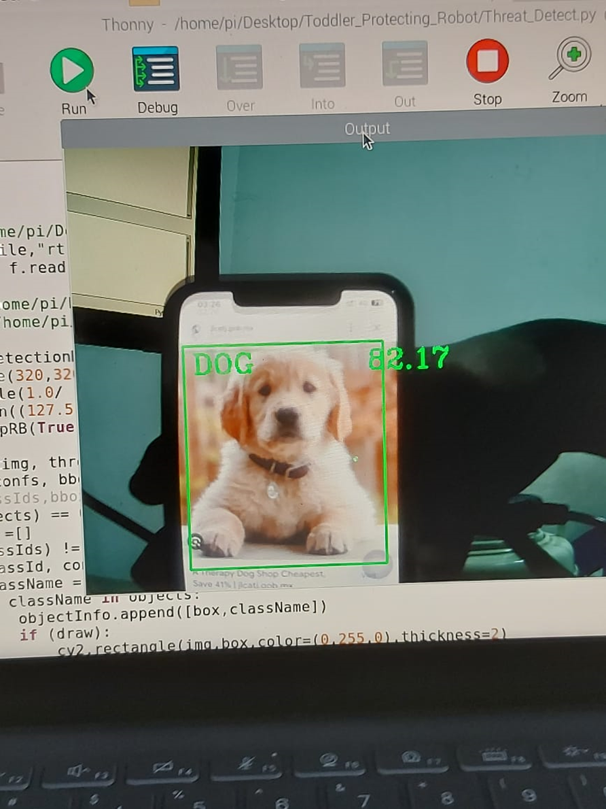
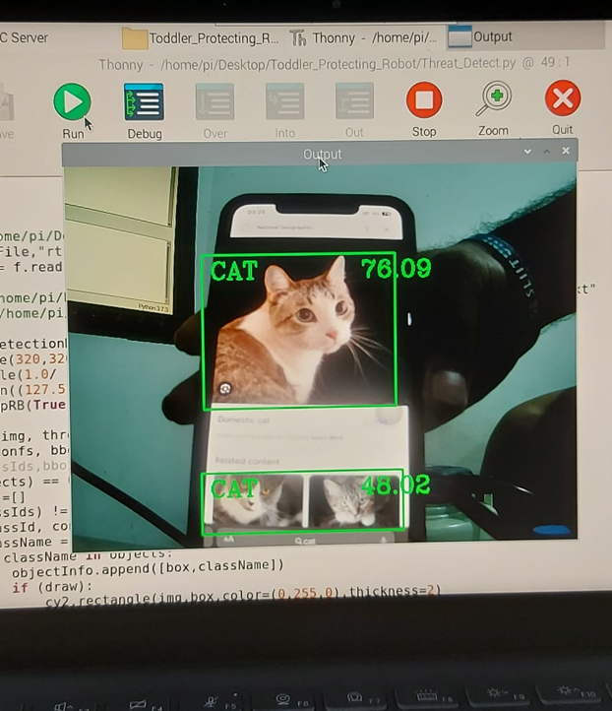
Testing and Results

Slide 21
References
[1] P. Sreevardhan, B. Vidheya Raju, and Durgesh Nandan, " Animal Repellents from Agricultural Fields," Department of Electronics and Communication Engineering, 2020. [Online]. Available: https://link.springer.com/chapter/10.1007/978-981-15-4851-2_12
[2] Waheb A. Jabbar, Saidatul N. I. S. Hamid, Akram A. Almohammedi, " 3) Internet of Things-Based Baby Monitoring System for Smart Cradle," July 2019. [Online]. Available:
https://ieeexplore.ieee.org/abstract/document/8760478
[3] Harish S; Sudesh Rao; Chethan P, “Research on Survivalence of Rouge Wild Animals Using Image Processing and IOT,” Proceedings of 2019 1st International Conference on Advances in Information Technology (ICAIT), 25-27 July 2019, doi: 10.1109/ICAIT47043.2019.8987324.

Slide 22

IT20093150 | Lakshan W. R
BSc (Hons) in Information Technology
Specializing in Computer Systems & Network Engineering
- Toddler Crying Detection & Automate Lullabies Playing System -

Slide 23
Introduction
Developing a system that can automatically generate music or soothing lullabies in response to the cries of a toddler.
Parents are able to create a playlist by adding toddler's favourite songs or lullabies via music application. (Such as Spotify).

Slide 24
Objectives
To provide opportunities for busy parents to look after their children when they are away from home.
To avoid disturbances when the baby sleeps and cries.
To give the opportunity to have a free mind for child as well as parents.

Slide 25
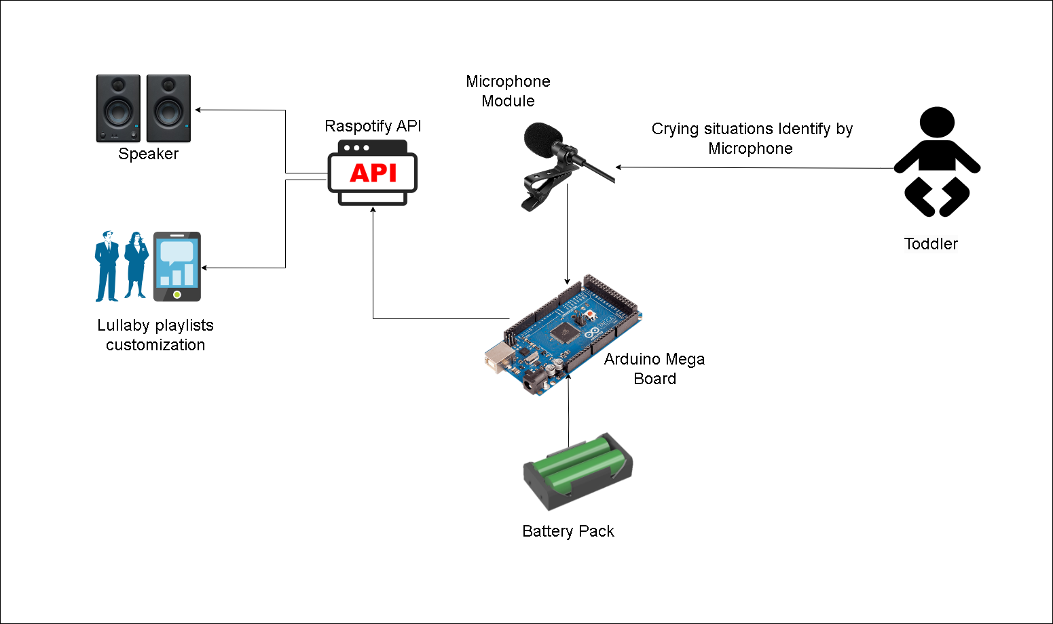
Methodology

Slide 26
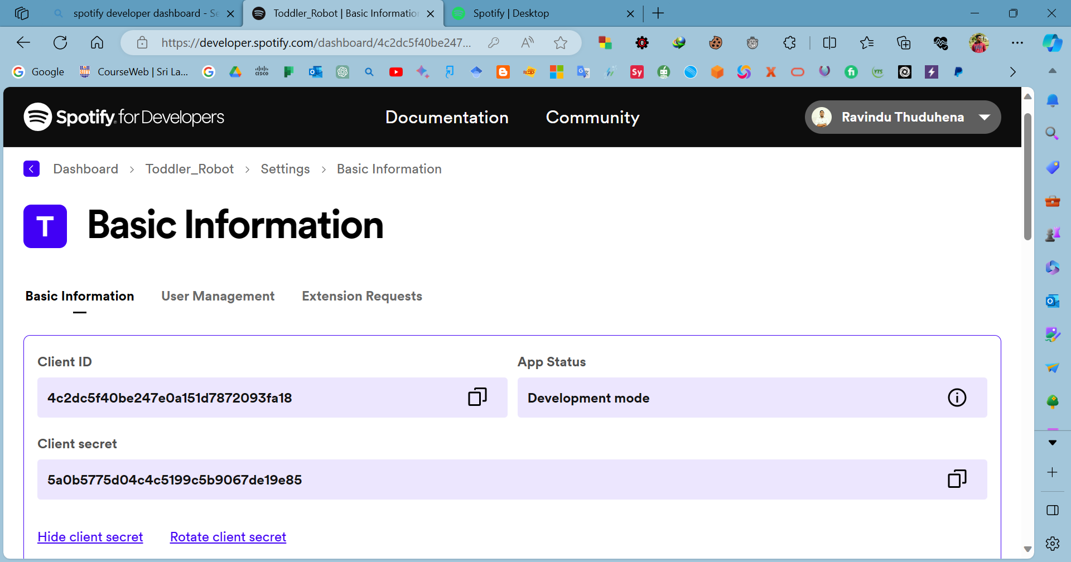
Testing and Results

Slide 27
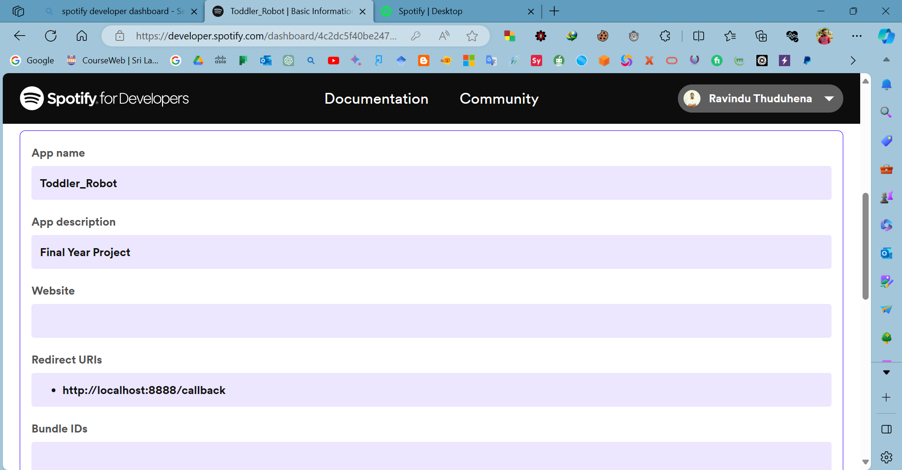
Testing and Results

Slide 28
References
Swapnil Bhatnagar, Sharjeel Hasan, "Automatic Cradle System for Infant Care," ResearchGate, May 2021. [Online]. Available: https://www.researchgate.net/publication/351686843_Automatic_Cradle_System_for_Infant_Care.
Rami Kohen, Yizhar Lavner, "Infant Cry Analysis and Detection," IEEE, 2012. [Online]. Available: https://ieeexplore.ieee.org/document/6376996.
Inoka Silva, Sampath Wickramasinghe, "Infant Cry Detection System with Automatic Soothing and Video Monitoring," ResearchGate, January 2017. [Online]. Available: https://www.researchgate.net/publication/342802422_Infant_Cry_Detection_System_with_Automatic_Soothing_and_Video_Monitoring_Functions.

Slide 29

IT20136260 | Maddepola M.A.D.K.B
BSc (Hons) in Information Technology
Specializing in Computer Systems & Network Engineering
- Toddler behavior detection & alerting System -

Slide 30
Introduction
Parental concerns about understanding child's behavior and surroundings when they are away are prevalent
Existing methods of communication often fail to provide accurate and timely information to parents regarding their child's behavior and environment

Slide 31
Objectives
It detects the child's behavior when he sitting, sleeps or climbs into a dangerous area, and alerts parents through an alarm system in case of animal invasion and crying.
It detects the child's behavior when he sitting, sleeps or climbs into a dangerous area, and alerts parents through an alarm system in case of animal invasion and crying.

Slide 32
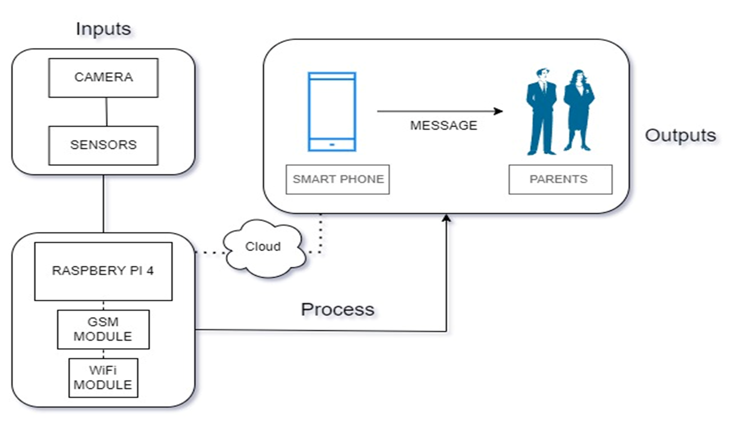
Methodology

Slide 33
References
[1] Z. Zhang, "Robotics," Research on Childcare Robot and the Influence on, vol. 10, p. 9, 2022.
[2] D. M. H. C.S. Shivaraj, "International Research Journal of Engineering and Technology," ARTIFICIAL INTELLIGENCE FOR HUMAN BEHAVIOR ANALYSIS, vol. 05, no. 06, p. 8, June-2018.
[3] Y. Liu, "A Robotic Prototype System for Child Monitoring," in International Journal of Robotics and Automation (IJRA), vol. 2, no. 1, 2011, pp. 65.

Slide 34

Standards & Best Practices
Use of Gitlab as a centralized repository for code management.
Use of appropriate naming conventions in the codes.
Comment & document the codes.

Slide 35
Professional, Legal, Social, Security and Ethical Issues
Monitoring of personal and sensitive information can have a legal impact on some countries and regions.
Solution: Privacy and Data Protection - Address privacy concerns by implementing strong data protection measures to secure any information collected by the robot.
Example: Comply with data privacy laws and regulations, such as General Data Protection Regulation (GDPR) in Europe.
Physical Security.
Solution: Ensure that the robot is built with safety features to prevent it from causing harm to children and that it cannot be manipulated or used for harmful purposes.

Slide 36

Non-functional Requirements
Mobility
Maintainability
Scalability
Flexibility
Ethical Considerations

Slide 37
Commercialization
Target audience: parents, caregivers, childcare centers, and prenursery school engaging children of age 1 - 4
Unique selling points of the product:
Detecting threats while monitoring toddler environment.
Identifying dangerous behaviors of the toddler.
Makes a perfect environment for the toddler.
Develop the robot design in toddler friendly manner.
Marketing Plan
Online/content marketing:
Build a professional website that showcases our product's features, benefits, and pricing.
Use social media platforms to engage with your audience and promote our product.
Influencer Marketing:
Partner with parenting influencers, bloggers, and experts who can review and promote your product.
Attend industry-related events and trade shows to showcase our product.

Slide 38

Demonstration

Slide 39

Questions ?

Slide 40
Thank YOU !!!

